Slide 1
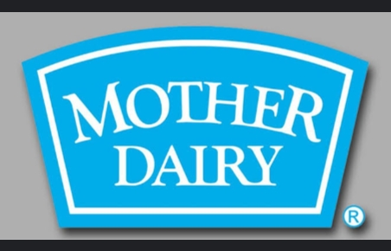


Mother Dairy
Mother Dairy was commissioned in 1974 and is
a wholly owned subsidiary of the National Dairy
Development Board (NDDB).

Slide 2
d studey
/Brand study::nmother diary is a well known brand In india primarily it is recogized for its diary products.
Brand study, competitor analysis and buyer's /audience's persona
Mission /values:To lead the market with dairy products that are high quality, and ultra-heat treated through good manufacturing processes, and safe and best choices for human consumption.

Slide 3

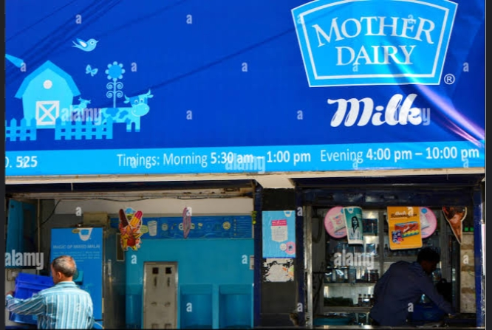
Usp:mother dairy has a strong focus on digital transformation services and provides best quality to the customer.
Brand tone and identity :The campaign talks about the brand that cares just like a mother. The milk products consumed by the kids and teenagers are made with such care no less than their own mother.

Slide 4
Smart goals:To sustain market leadership in the production and marketing of a variety of liquid milk and milk products with assured quality at an affordable price.
5 KPIS for mother diary:Quality of the product
-- Availability of the product
--Packing of the product
-- Price of the product
-- Healthy product

Slide 5
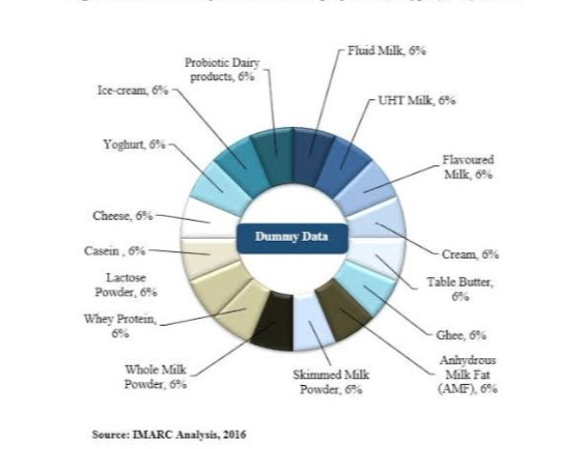
Buyer's /audience's personna :
The target customers of Mother Dairy include Middle and upper-middle-class families. They are of varied age groups as Mother Dairy has a variety of products catering needs of young children to adults.

Slide 6
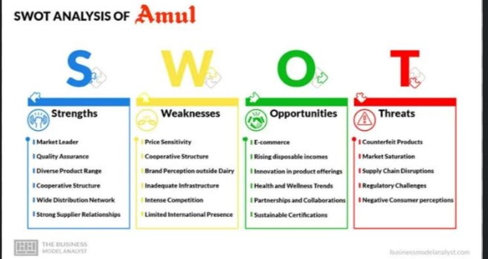
Competitor analysis:
Competitor 1: Amul is a leading Indian dairy brand owned by Gujarat Co-operative Milk Marketing Federation Ltd. It is one of Mother Dairy’s closest competitors with a large market presence.

Slide 7
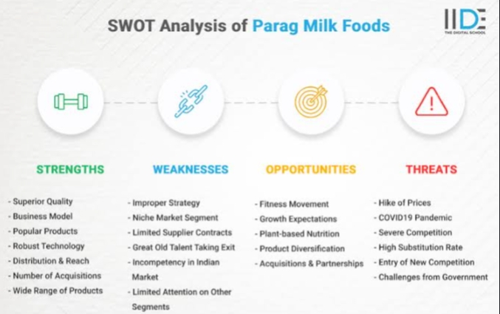
Competatior 2:Prag Dairy is a leading dairy brand owned by Prabhat Dairy Pvt. Ltd. It is a major competitor for Mother Dairy in the Indian market.

Slide 8
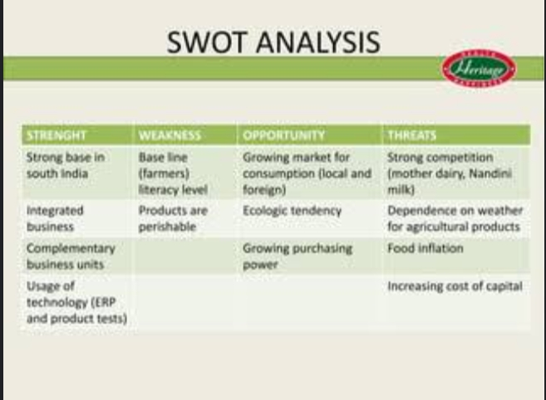
Competatior 3: Heritage Foods is an Indian food-products corporation. It owns the dairy product brand Heritage and is a major competitor for Mother Dairy in the Indian market.

Slide 9
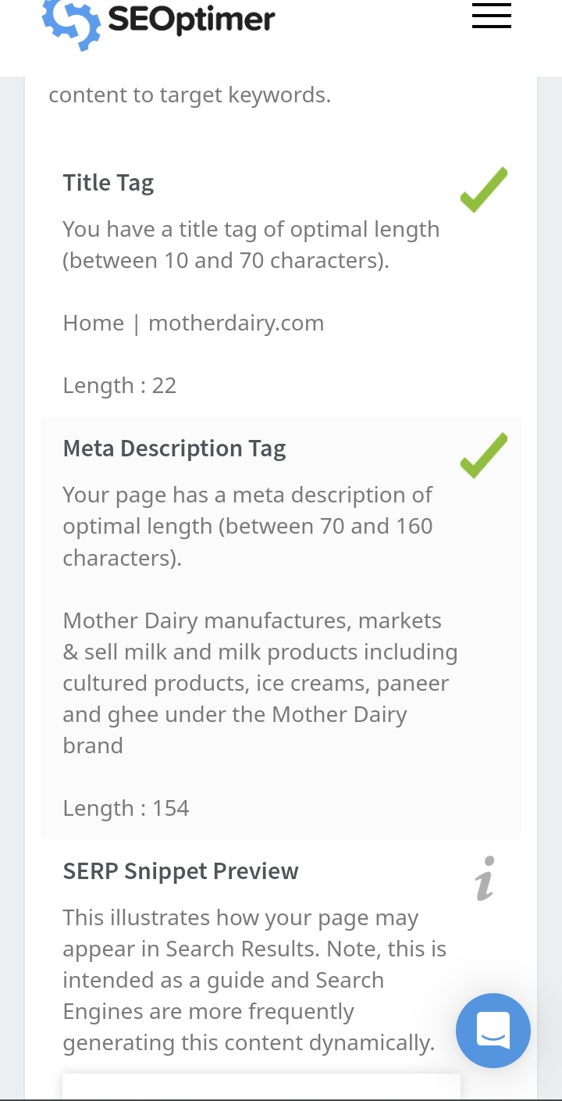
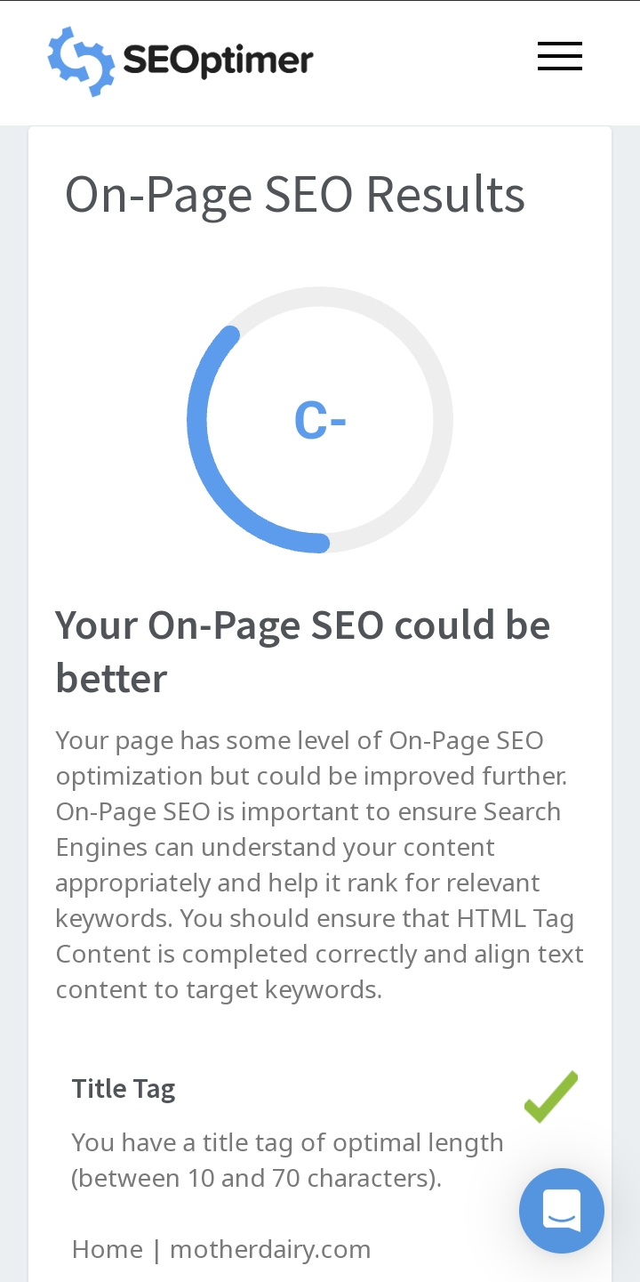
SEO & KEYWORD RESEARCH
Seo audit:

Slide 10
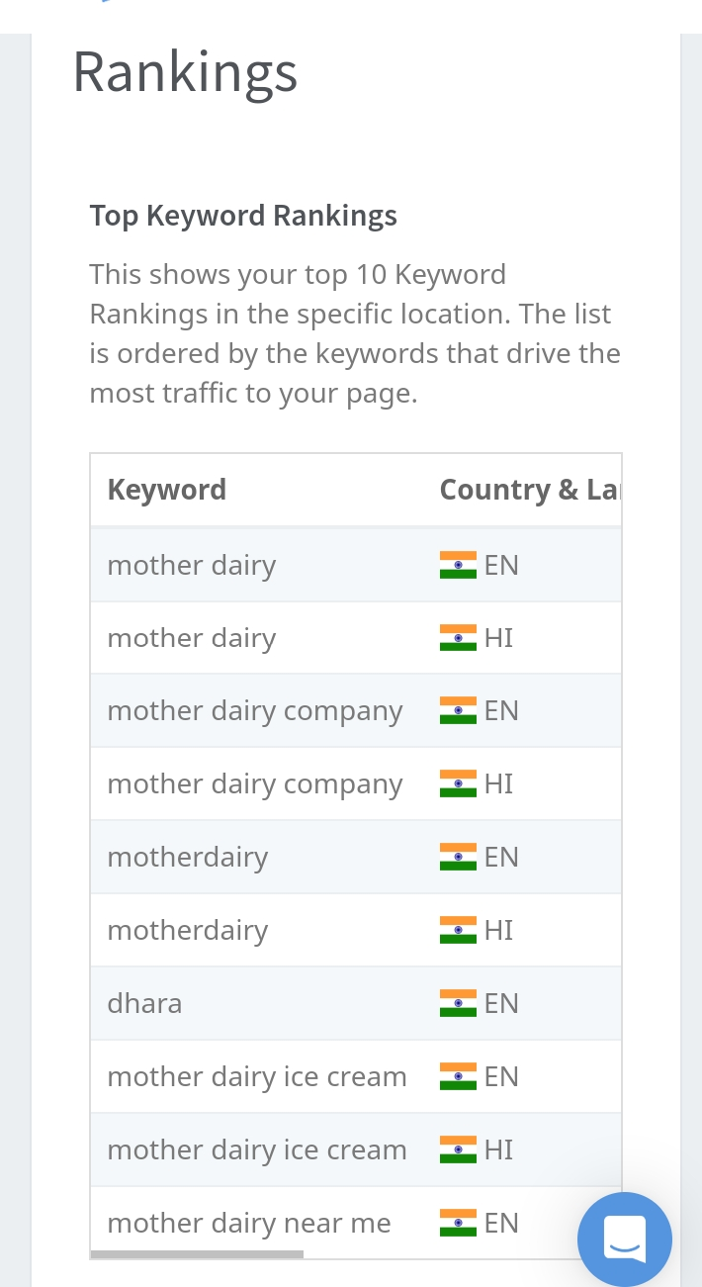
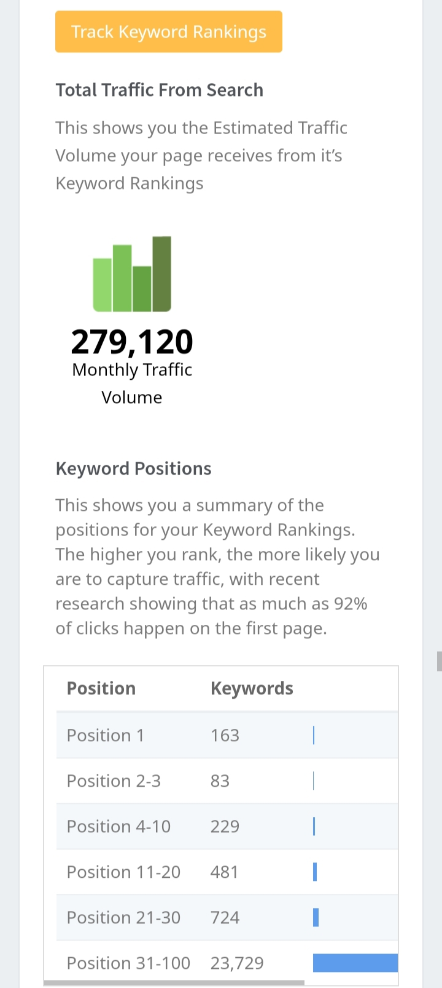
01%
02%
03%

Slide 11
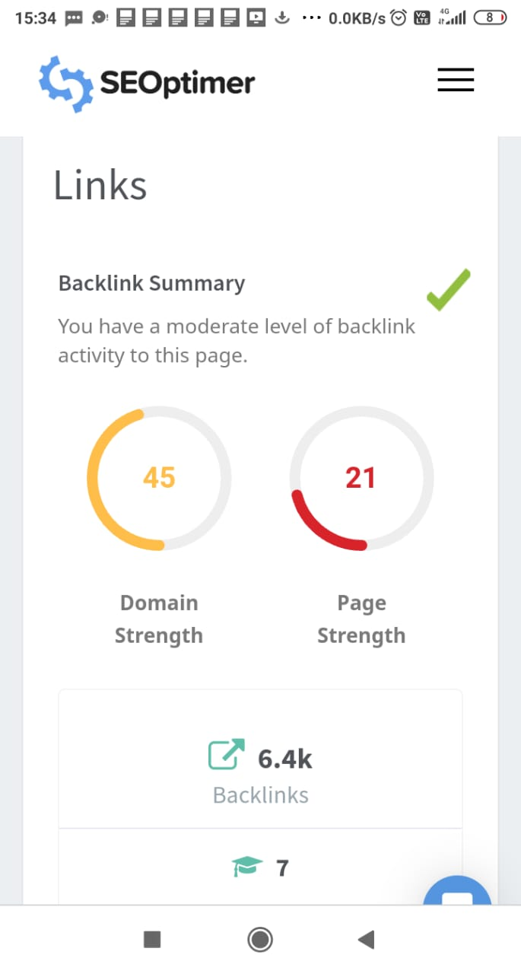
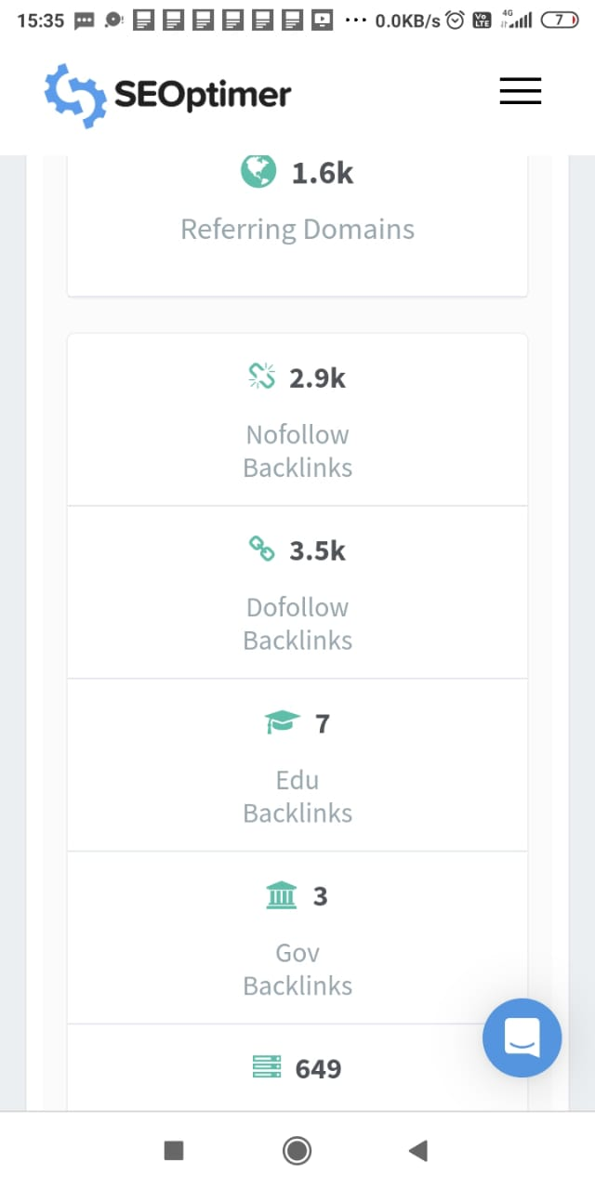

Slide 12
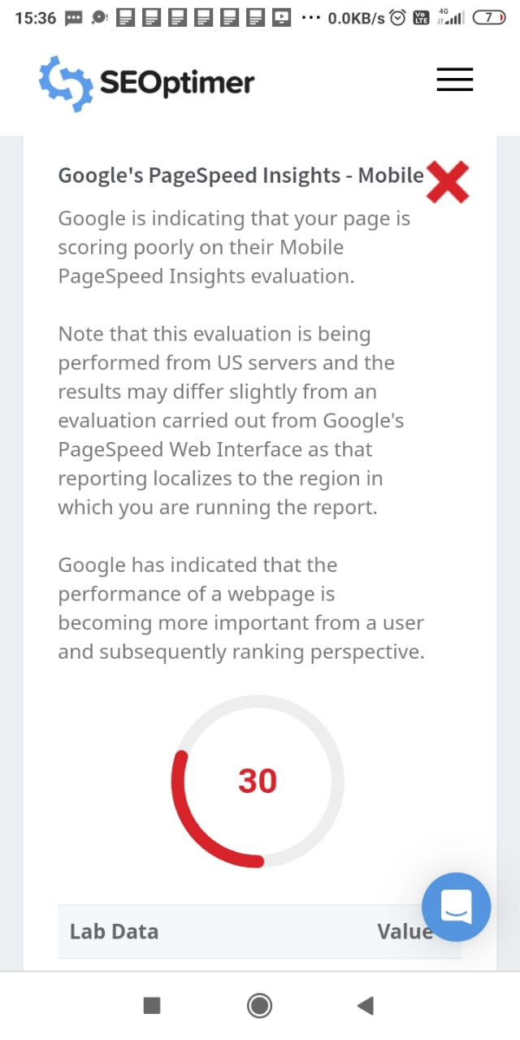
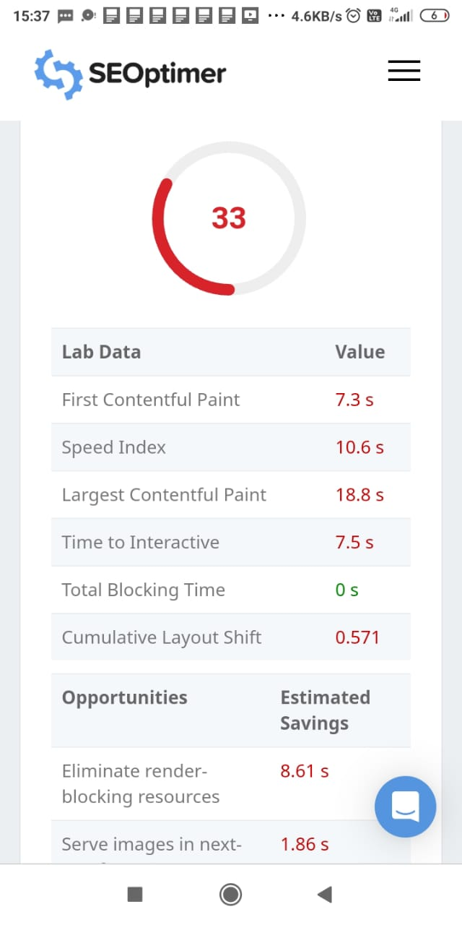
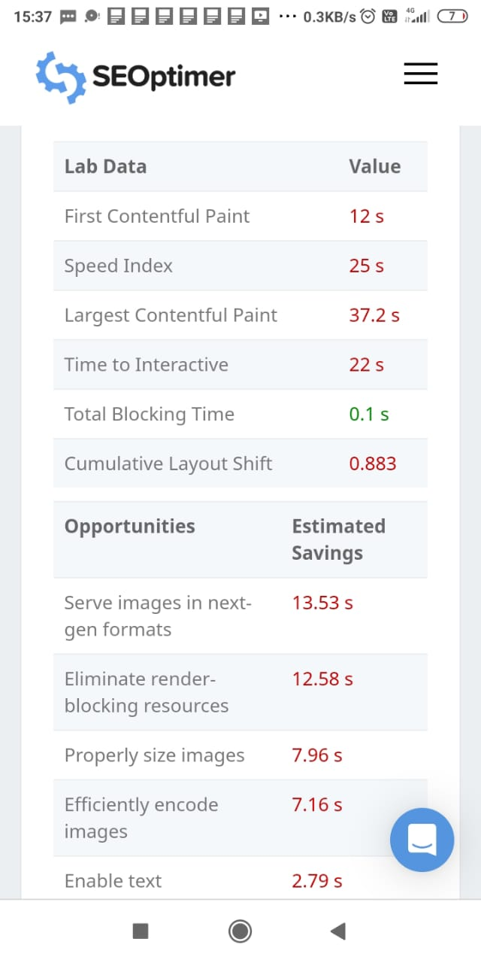

Slide 13
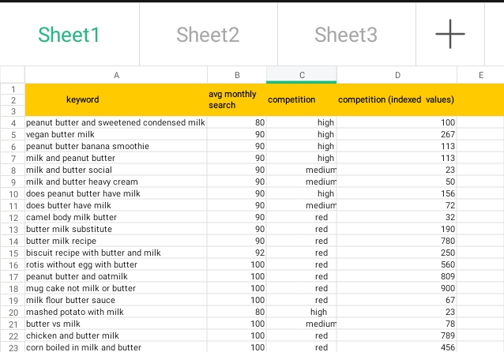
Keyword research:
2

Slide 14
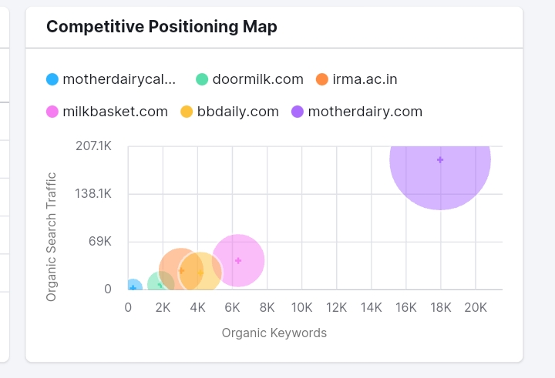
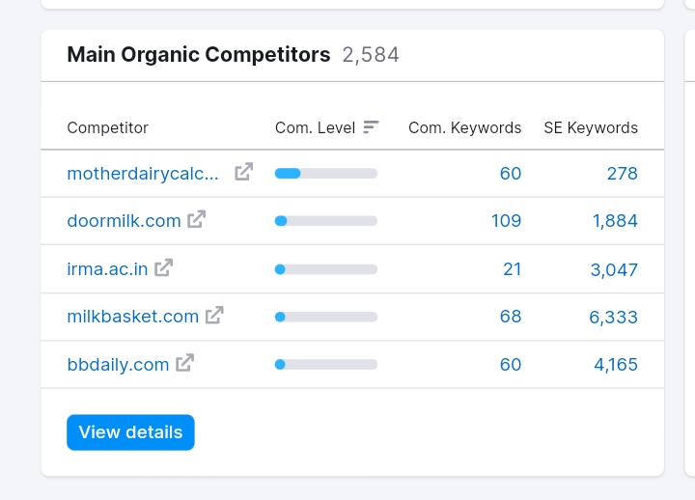
Competatior Analyze:

Slide 15
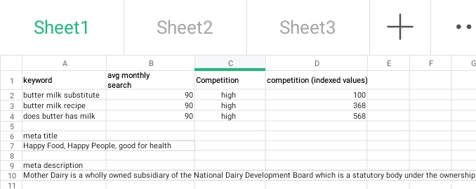
On page optimization:

Slide 16

Content ideas and marketing strategies:

Slide 17
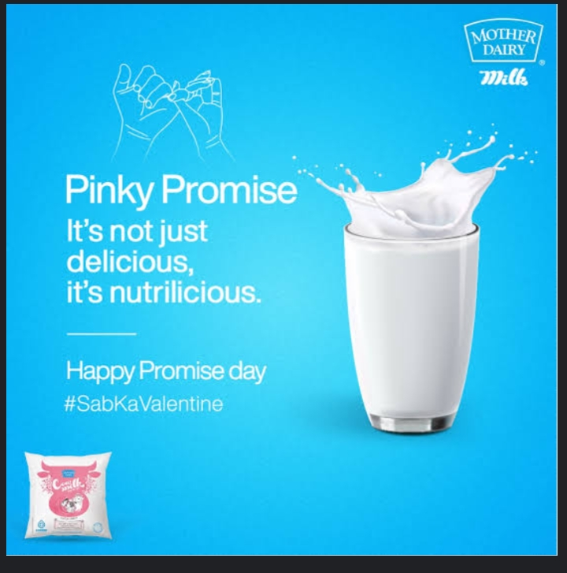
Content creation and curration:
Mother dairy is a fresh milk and is sourced directly from state level cooperatives.... Buynow

Slide 18

"Experience the richness of milk with Mother Dairy." It is natural milk product and good for health....see more

Slide 19
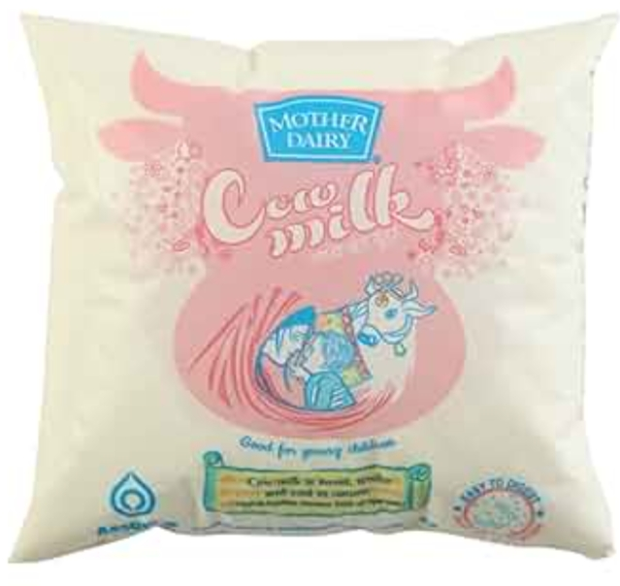
Description Mother Dairy Milk is an entire pack of nutrition necessary for your health development and growth. It is equally nutritional like the total milk with Vitamin A and D. There is completely no fat containing all.
over............
Visit here

Slide 20
Instagram story :
https://instagram.com/stories/thecosmeticcreations1/3212041561059454887?utm_source=ig_story_item_share&igshid=YjA3ZDljY2FiMw==
https://instagram.com/stories/thecosmeticcreations1/3212515966252275310?utm_source=ig_story_item_share&igshid=YjA3ZDljY2FiMw==

Slide 21
Thank you
Team leader
Nikitha Panigrahi
Team members
Menda sravani
Sara sobitha
Sathivada akhila
Saipally jyothi

